Slide 1



Co-Terminus
Touch-less Alternative For Keypad

Slide 2



Pr blem
Corona virus mainly spreads due to contact.
One such unavoidable point of contact is touching(pressing) keys for input on various machines used in day to day life, be it in households, offices or commercial place.
So a long term solution is needed for places frequently visited by users and hence there is a prime need to make these inputs touch-less.
02

Slide 3

03
Solution
Our solution to this problem is installing a touch-less interface, i.e., we need not to touch the hard press keys on various publicly used machines, instead input will be taken by the machine using a set of lasers that will track motion of our finger to determine the right key to be pressed.
The Utopia

Slide 4




Pr duct or Service
A touch-less alternative to hard key press machines using lasers that will track finger motion for inputs.

Slide 5
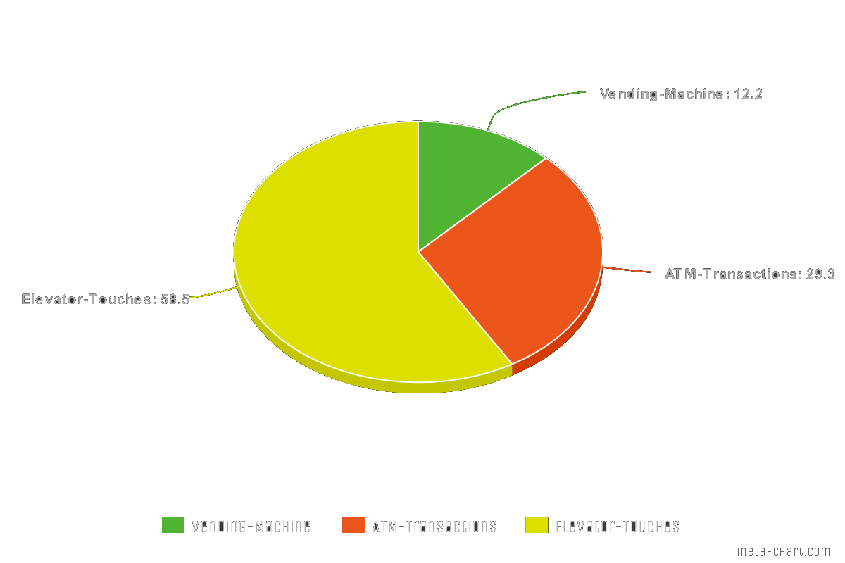
STATISTICS
05
On an average there are :
120 transactions on every ATM
240 number of touches on an elevator keypad
50 transactions on an Vending Machine keypad
in a day.

Slide 6
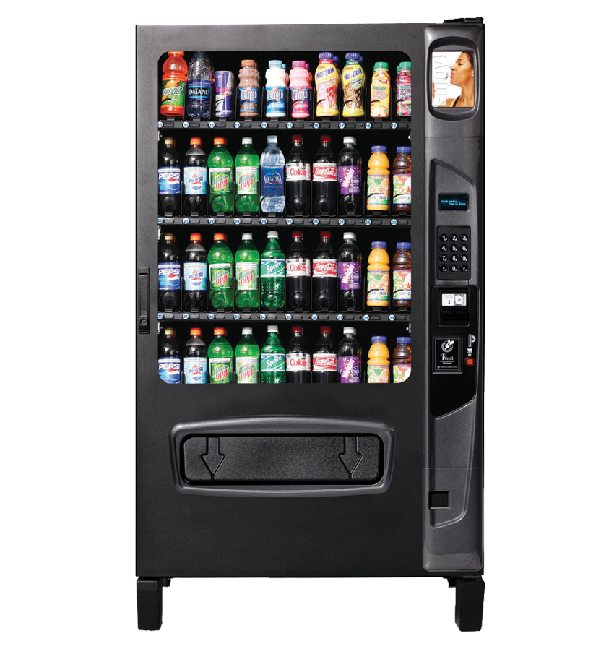
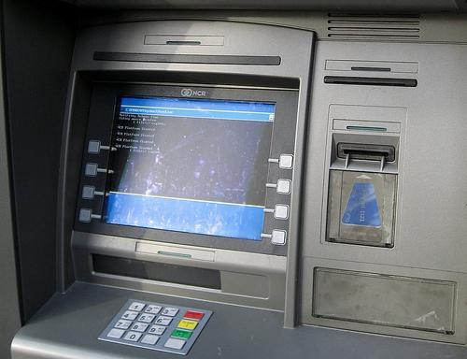

06
Target Market
Machines having Keypad in public places

Slide 7


Size the Market
Total Available Market (TAM)
64.8
Lakhs
ATM
Elevators
Vending Machine

Slide 8
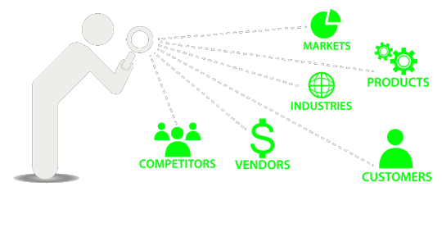
08
Advantage 1
Advantages
There are some hackers who use thermal imaging cameras after you leave the ATM vestibule to find out your pin by analysing the temperature of the keys. This is possible because of the heat transfer from our body to the keys when we touch them. Our setup is therefore more secure than the existing input system
Advantage 2
Our device provides touch-less alternative to hard key press machines using lasers that will track finger motion for inputs, So no need to touch the potentially vulnerable keys.

Slide 9


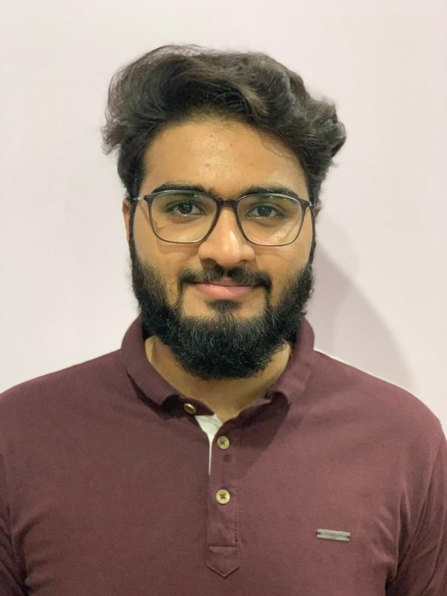
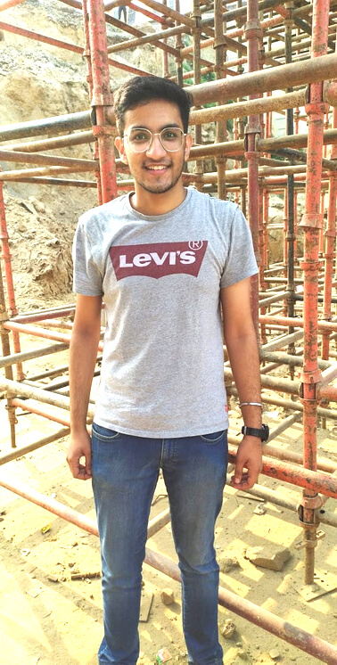
Ashish Kharbanda
An active member of public relations team of our collegeHas an innovative brain and a tendency to tinker with mechanical stuff to make out a useful product. Knows how to make 3D models using SolidWorks. Has participated and won several such competitions.
The Team
Mrityunjay Singh
Experienced in making mechanical projects and has a good understanding of each team member capabilities. Has a considerable knowledge about artificial intelligence and has hands-on experience in making facial expression recognition AI software.
Rahul Madan
Has a good understanding of present public needs and our target segment of society. Has been experimenting with electronic stuff for last 6 years and has gained a lot of knowledge which is required for our product development.

Slide 10



Contact Us
+91-8929333770
coterminus101@gmail.com

